Slide 1
Creative Case/Let’s Create 2020-2030
Creative Case for Diversity launched in 2011 to address inequalities in the sector.
Impact – it has helped focus attention on what cultural organisations produce, present, collect – has given some voice to talented creative practitioners who have been overlooked
Still vital and still more work to do
Now need to build on Creative Case to address lack of diversity and inclusivity in organisations’ leadership, governance, workforce and audience
“Collectively, the organisations we support will represent the diversity of this country. Individually, they will work in ways that are valuable to, and valued by, their communities, creative practitioners and partners”

Slide 2
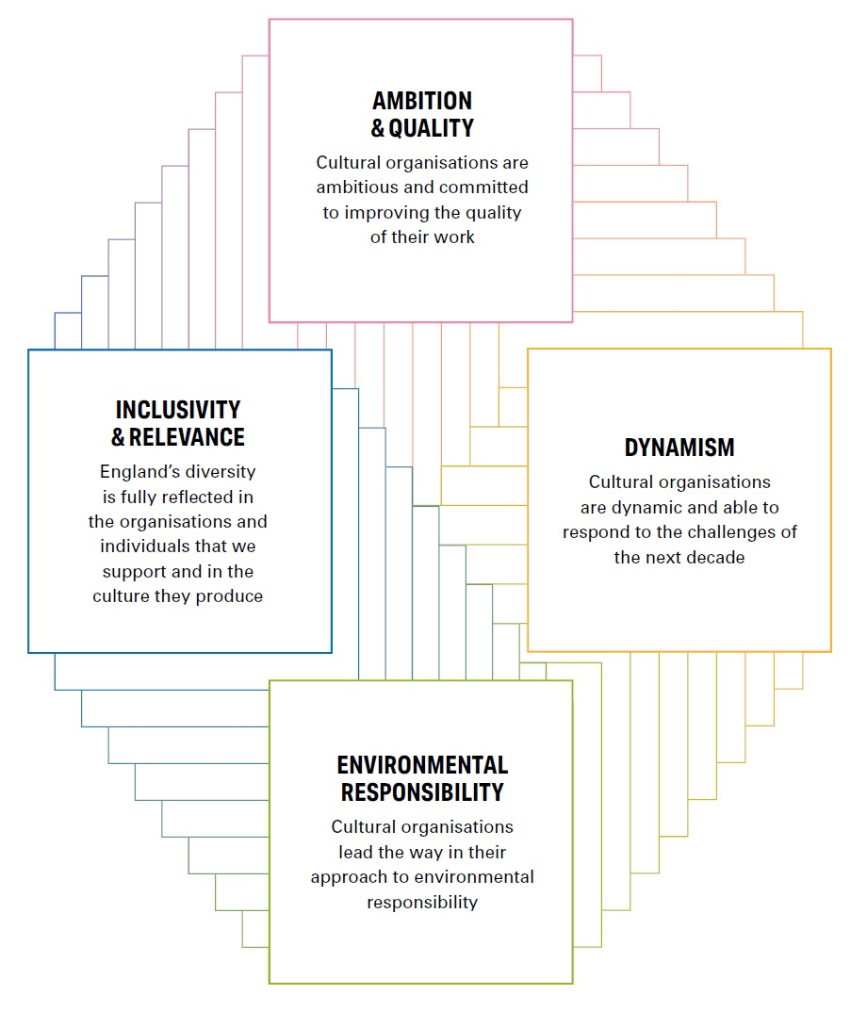
ACE INVESTMENT PRINCIPLES
“Under these Principles, all of the organisations that we fund will be dynamic, highly collaborative, inclusive and relevant in the way they work and the culture they produce, and champions of good leadership. They will be ambitious, and constantly seek to improve the quality of their work. They will be leaders in their communities in their approach to environmental responsibility and will be able to demonstrate their success through creative and business innovation.”
Let’s Create, Strategy 2020 - 2030

Slide 3
Communities
You are actively listening to, and taking account of, the views of the local community, children and young people, artists, practitioners, and stakeholders you work with. You actively form relationships with your underserved communities. As a result you matter more to more people.
Workforce, Leadership and Governance
You have a workforce, leadership and governance which fully reflects and represents the communities you are serving. You have an inclusive organisational culture which values and develops the talent of all the people you work with. You foster a safe workplace where harassment and discrimination can be challenged and eliminated.
Creative Case for Diversity
Your programmes and activities reflect the culture and talent of creative practitioners and cultural workers drawn from all backgrounds.
England’s diversity is fully reflected in the individuals and organisations we support and the culture they produce
The core characteristics of Inclusivity & Relevance

Slide 4
What is Inclusivity and Relevance - what does it mean for you?
In breakouts discuss:
What does Inclusivity and Relevance mean for your organisation?
How do you embed it throughout your organisation?
What does authenticity look like in this context?

Slide 5
THE OUTCOMES
The relationship between Inclusivity & Relevance and the three Outcomes
CREATIVE PEOPLE
Everyone can develop and express creativity throughout their life
CULTURAL COMMUNITIES
Villages, towns and cities thrive through a collaborative approach to culture
A CREATIVE & CULTURAL COUNTRY
England’s cultural sector is innovative, collaborative
and international

Slide 6
Creative People
Everyone can be creative, and each of us has the potential to develop our creativity further. Taking part in creative acts such as singing, photography or writing delights and fulfil us, and helps us to think, experiment, and better understand the world
Cultural Communities
Culture and the experiences it offers can have a deep and lasting effect on places and the people who live in them. Investment in cultural activities and in arts organisations, museums and libraries helps improve lives, regenerate neighbourhoods, support local economies, attract visitors and bring people together
A Creative & Cultural Country
To achieve the first two Outcomes, we need a professional cultural sector that generates new ideas, works easily and effectively with others, and is adept at developing diverse talent from every community. It should aspire to be world-leading – in the way it makes art, in the imagination and expertise with which it makes exciting use of collections and develops libraries, and in the culture it creates and shares

Slide 7
The relationship between Inclusivity and Relevance and the three Outcomes
In breakouts discuss:
What is your overarching narrative over the three years for your contribution to the Outcomes? What difference are you aiming to make?
What is your activity (overview)?
Prompts:
- Who do you represent? Who are you not representing or underserving and why?
- What activity (internal and external) are you currently undertaking?
- What activity (internal and external) do you need to undertake?

Slide 8
Inclusivity and Relevance Plan template
1. Ambition – what you want to achieve in three years and how you will know you have succeeded (the change you are working towards and the evidence you will use to know that you have succeeded)
2. Priority for next 12 months (what your focus will be)
3. Actions (how you will achieve this)
Up to three under each heading – these can be already established (you may be doing this already), in progress or planned
- Skills development (for your workforce, leadership and governance)
People & representation (groups and experts that you will work with)
Planning (plans and policies that you have, or will create)
Tools & monitoring (tools & resources that will help you set, monitor and report)

Slide 9
Example

